Slide 1


Adarsh Institute of Technology &
Research Centre, Vita
Department of Computer Science & Engineering
Class-TY
Mini Project Presentation on
“Daily Expense Tracker”
Team Members :
Miss. Kirdat Mayuri Jagannath (CS3001)
Miss. Pawar Nikita Jagannath (CS3002)
Miss. Nikam Siddhi Ashok (CS3003)
Miss. Sawant Rutuja Krushnat (CS3004)
Academic Year
2023-2024
Under Guidance of
Asst. Prof. Miss. S. L. Jadhav

Slide 2
Index
Introduction
Literature Survey
Existing System
Proposed System
Requirement Analysis
System Design
Screenshot
Future Scope
Conclusion
References

Slide 3
Introduction
Application allows users to maintain a digital automated diary. Each user will be required to register on the system at registration time, the user will be provided id, which will be used to maintain the record of each unique user.
Expense Tracker application which will keep a track of Income-Expense of a user on a day to day basis. So daily expense tracker will help them manage their needs and spending in a better way by accessing the web application directly from web browsers

Slide 4
Literature Survey
Sr.no | Title of Paper | Author | Year | Paper Gist
1. | Daily Expense Tracker | Shivam Mehra, Prabhat Parashar UG Student, Department of Computer Science and Engineering HMR Institute of Technology and Management, Delhi, India. | IEEE2021 | Daily Expense Tracker is a web application that allows you to track the daily expense of the user and help them to better manage their resources. It creates a digital record of the income and expense of the user.

Slide 5
Sr.no | Title of Paper | Author | Year | Paper Gist
2. | Daily Expense Tracker | Tamia Ruvimbo Masendu, Aanajey Mani Tripath | IEEE 2022 | This important characteristic about this application is that amount you perform tune thane expense by means of citing date, month yet year. Strengthens a systematic provision as a choice help in conformity by users financial administration and foretelling future budget planning
3. | Daily Expense Tracker | 1)Sakthivel.M, 2)Roshini.P, 3)Roja.K, 4)MahaLakshmi.P 5)Keerthi.V | IEEE 2023 | Personal Expense Tracker which keeps track on your savings and expense and alerts the user if the limit exceeds. Daily based expense tracking guides us saving more money.This system makes you to be in control and win your intention.

Slide 6
Existing System
Builds Discipline And Organization.
Forces you to think about money.
Crisis prevention.
Budget planner.
Knowing your spending habits.

Slide 7
Proposed System
• Users can create personalized accounts to access the system’s features.
• Expense tracker can be developed enable user to manage their daily expense in their busy and expensive life.
• Expense tracker provides to user to store expense in daily routing with different categories with dates, so that we can easily access our expense.
• User can access or use the interface easily

Slide 8
Requirement Analysis
SOFTWARE REQUIREMENT:
1) Chrome, Mozilla Firefox, safari etc.
2) Windows 7(32bit) or higher versions.
3) XAMPP server.
4) Visual Studio Code.
HARDWARE REQUIREMENT:
1) i3,i5 Processor based computer.
2) Internet connection.
3) RAM 512GB or more.
4) 5 GB Hard disk

Slide 9
System Design
Database
Web
Services
Login
Register
Dashboard
Total Expense
Expense List
Add Expense
Profile
Logout

Slide 10
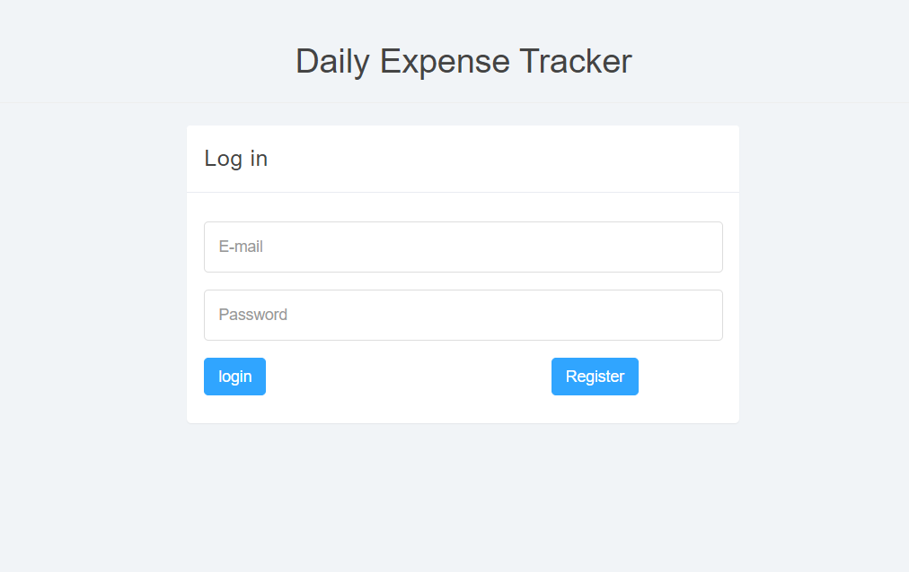
Screenshots

Slide 11
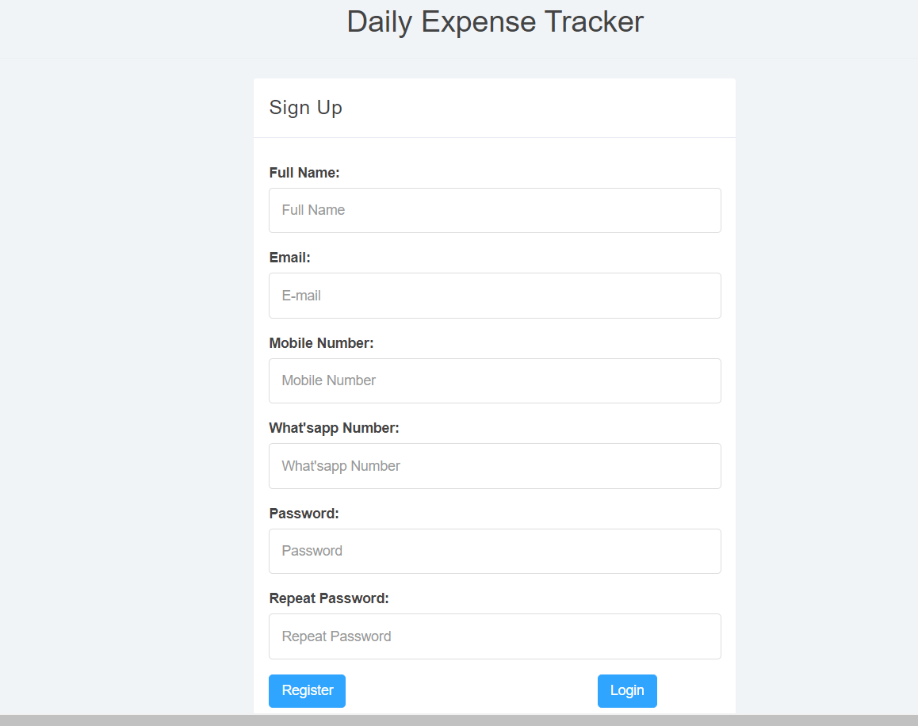

Slide 12
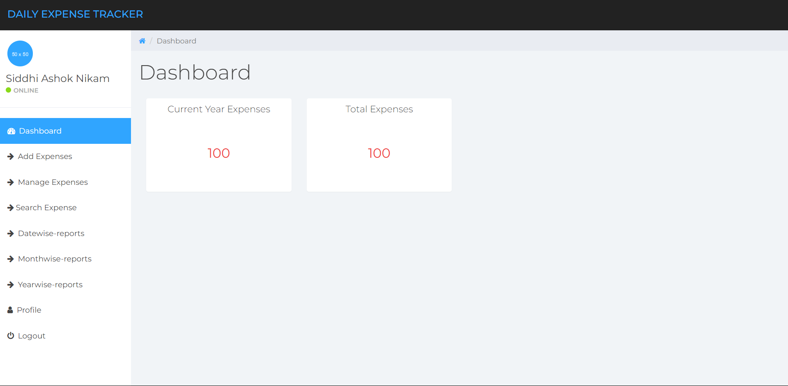

Slide 13
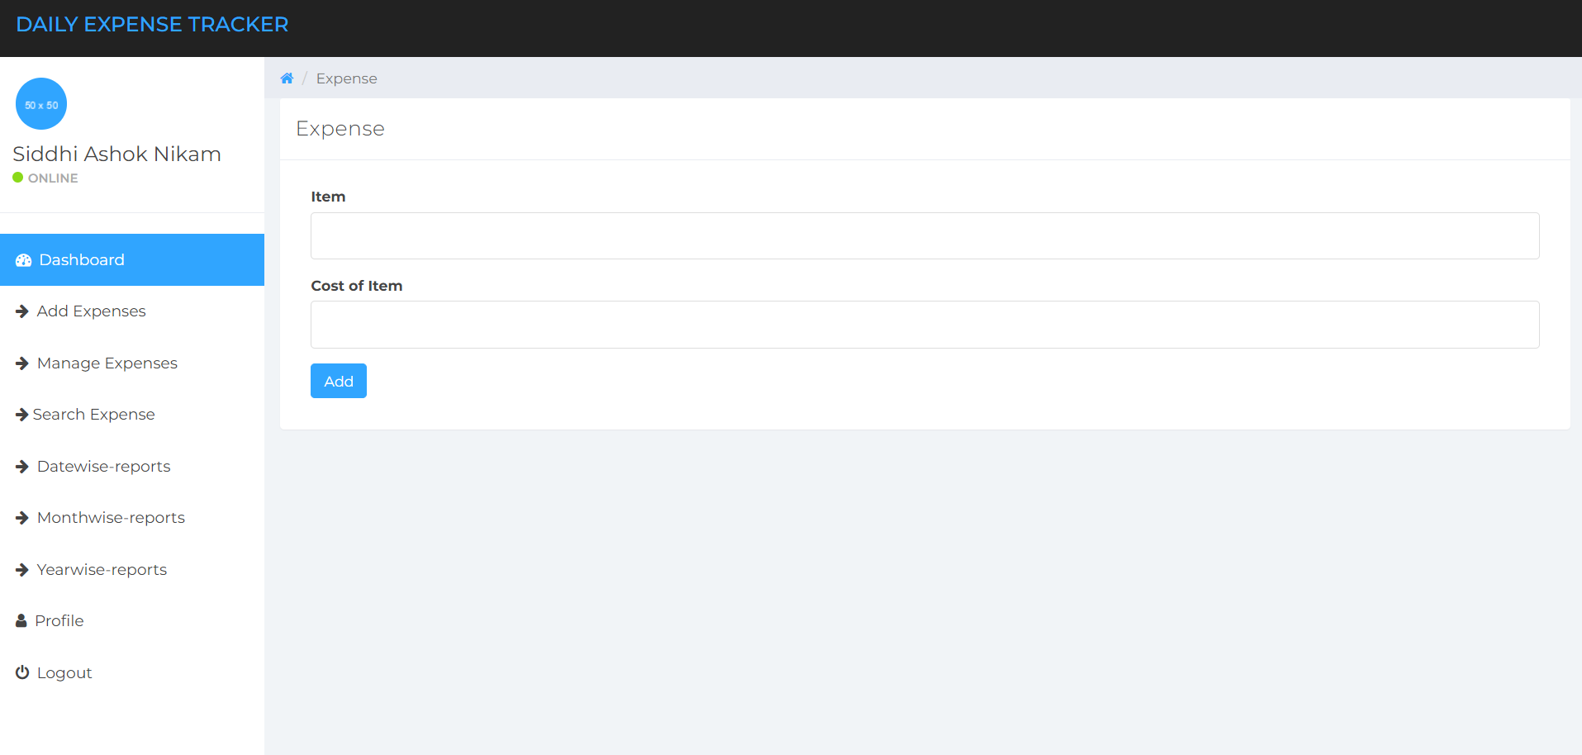

Slide 14
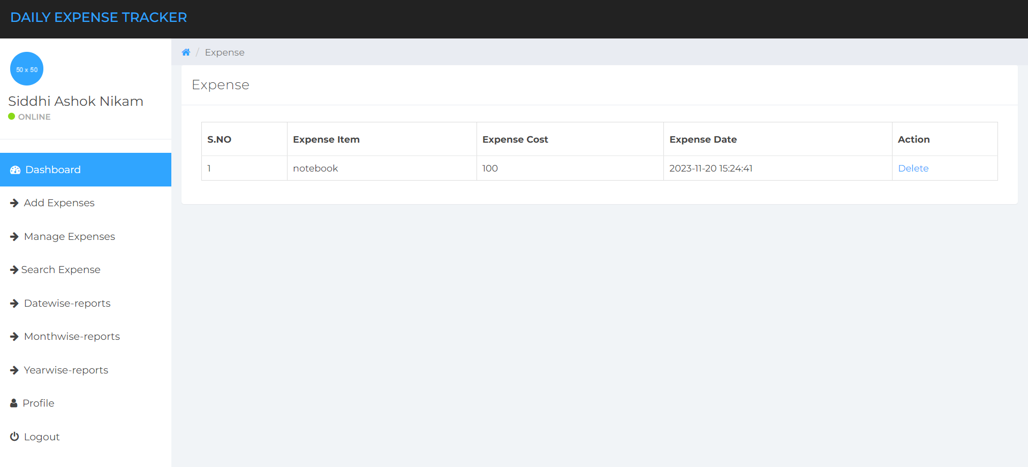

Slide 15
Future Scope
• Include currency converter.
• Reports are created in category wise any format.
• Multiple account support.
• History can be set to view all the details in the app even if the particular data is deleted from the database.
• Sharing files via Bluetooth, WhatsApp can be allowed.
• User can add their Profile photo.

Slide 16
Conclusion
1) Identifying Unnecessary Expenses.
2) Promoting Better Financial Planning and Budgeting.
3) Helping in Achieving Financial Goals.
4) Enabling Better Control Over Your Finances.

Slide 17
References
1.https://www.irjet.net/archives/V6/i3/IRJET-V6I31110.pdf 2.https://www.irejournals.com/formatedpaper/1702687.pdf 3.https://www.ijres.org/papers/Volume-9/Issue-12/Ser-4/L09127073.pdf 4. https://ieeexplore.ieee.org/abstract/document/9396201
5. https://youtu.be/yp5pYIg4WHc?si=FoNDi2EvJn3Qd1bE
6. https://www.w3schools.com/

Slide 18
THANK YOU...!

